Slide 1
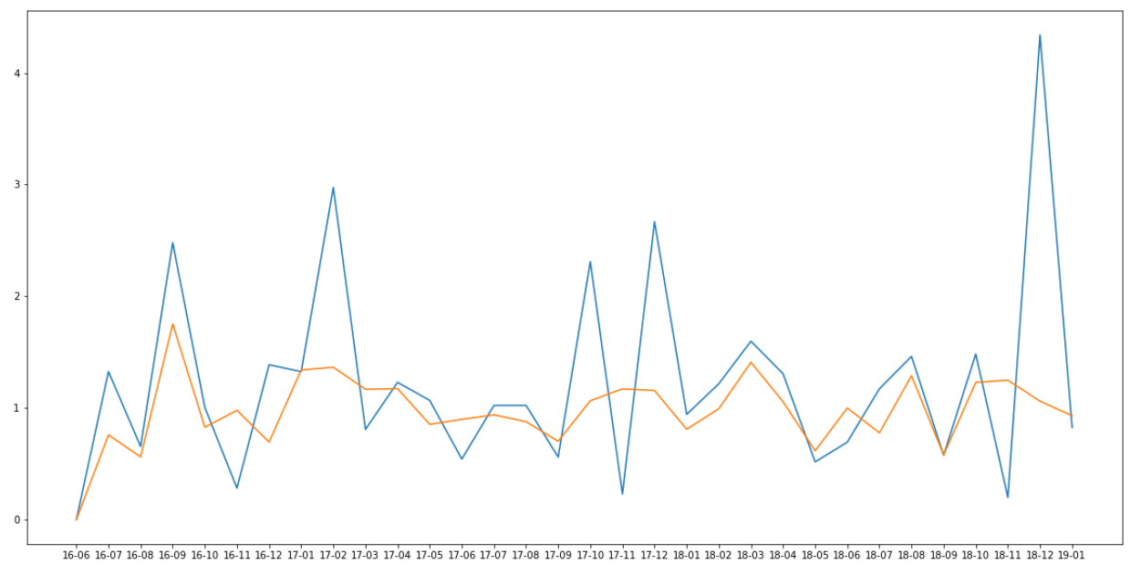
Monthly difference of recommendations and number of players
Blue = positive and negative reviews combined
Orange = Popularity of the game in players per month
Notes:
Here we see a graph of the monthly difference of recommendations and # of players. Observed is that the blue recommendation-line has more and higher peaks than the orange popularity-line. One would at first hypothesize that an increase in positive reviews will lead in an increase of players, however this is not the case. As seen in this graph, while the recommendations skyrocket, the difference in popularity stays balanced. Thus, can be concluded that at least for the tested games, the recommendations do not help the increase in players and most likely game-sales.

